Slide 1

Everything you need to know about SGX
FNCE6006-G1-Financial Econometrics
Group 2: Wengwei, Cao Danyang, Ma Tianqi, Luo Hao, Liu Qinglin

Slide 2
By Sector Analysis

Slide 3
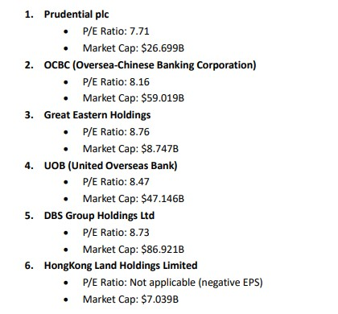
Finance Sector
Analysis based on P/E ratio and market cap
Prudential plc - Lowest P/E ratio among the listed, indicating potential undervaluation, combined with a significant market cap.
DBS Group Holdings Ltd - Although its P/E ratio is slightly higher than Prudential's, its market cap is the largest, indicating strong market presence.
UOB - Moderate P/E ratio and substantial market cap, indicating good stability and fair valuation.
Great Eastern Holdings - Higher P/E ratio compared to others, but still under 9, with a decent market cap.
HongKong Land Holdings Limited - Data on P/E ratio is not applicable due to negative EPS, indicating potential financial distress or other factors affecting earnings negatively, combined with the smallest market cap among those listed.

Slide 4
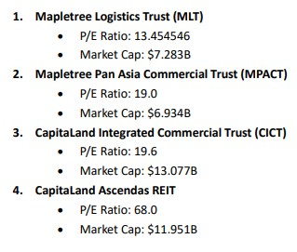
Real Estate Sector
Analysis based on P/E ratio and market cap
Mapletree Logistics Trust (MLT) - Offers the lowest P/E ratio among the listed, indicating potentially better value per earnings, combined with a substantial market cap.
Mapletree Pan Asia Commercial Trust (MPACT) - Second-lowest P/E ratio, suggesting reasonable valuation, though it has the smallest market cap among the group, indicating a slightly riskier investment.
CapitaLand Integrated Commercial Trust (CICT) - Similar to MPACT in terms of P/E ratio but possesses the highest market cap, indicating a larger and possibly more stable company.
CapitaLand Ascendas REIT - Highest P/E ratio among the group, suggesting it might be overvalued compared to the others, despite having a significant market cap.

Slide 5
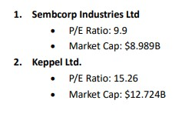
Oil & Gas Sector
Analysis based on P/E ratio and market cap
These two companies offer distinct investment profiles based on their P/E ratios and market capitalizations. Sembcorp Industries, with its lower P/E ratio, suggests a potentially more attractive valuation compared to Keppel Ltd., which has a higher P/E ratio but also a larger market cap, indicating it may be considered a larger and possibly more stable company.

Slide 6
Singapore Airline
P/E Ratio (TTM): 11.12 - This figure is relatively moderate, indicating that the stock might be reasonably valued compared to its earnings. A P/E ratio in this range suggests that the company's stock price is in line with what it earns, which could be seen as a positive sign for investors looking for potentially stable investments.
Market Cap: $18.857B - The substantial market capitalization of Singapore Airlines signifies its large size and the considerable value placed on it by the market. Large-cap companies like Singapore Airlines are generally considered to be more stable and less volatile than smaller companies, which can make them appealing to investors seeking lower-risk investments.
Dividend Yield: 5.96% - A high dividend yield can be attractive to investors looking for regular income from their investments. Singapore Airlines' dividend yield suggests it returns a significant amount of value to its shareholders in the form of dividends, which can be a positive factor for income-focused investors.
Financial Health and Growth Prospects: The Company has a balance of cash and debt that indicates a solid financial position, with total cash of $14.217 billion and total debt of $14.662 billion. The positive earnings growth and revenue growth indicate potential for future expansion and profitability.

Slide 7
Reflections
After analyzing the key sectors of the Singapore stock market from the perspectives of P/E Ratio and Market Capitalization, we conclude that beyond the conventional realms of Finance and Real Estate investments, the Petrochemical sector and Singapore Airlines equally merit investment consideration.
This leads us to our subsequent research focus, which entails an in-depth analysis of dividend distributions pertaining to the three major local banking stocks: DBS, OCBC and UOB.

Slide 8
Further Insight on Bank Stocks

Slide 9
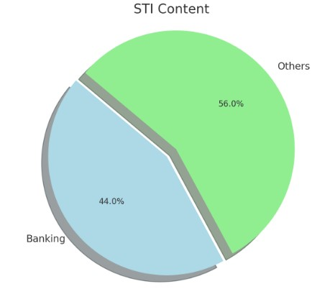
Research Subjects
To understand the dividend situation in the Singapore market, we must first grasp the overall context. The Straits Times Index (STI) is a crucial stock market index in Singapore that captures the performance of the top 30 companies listed on the Singapore Exchange (SGX). These entities are among the most substantial and liquid, and they span across various industries, providing a diversified exposure to sectors such as banking, telecommunications, aviation, and more. Which have Stable cash flow and mature business model that can provide sustainable dividends every year. Key players within the STI include DBS Group Holdings, Oversea-Chinese Banking Corp, and United Overseas Bank, which collectively account for approximately 44% of the index's weight. By analyzing the dividend payouts of these three banks, we can gain insights into the broader dividend landscape of the Singapore market.

Slide 10
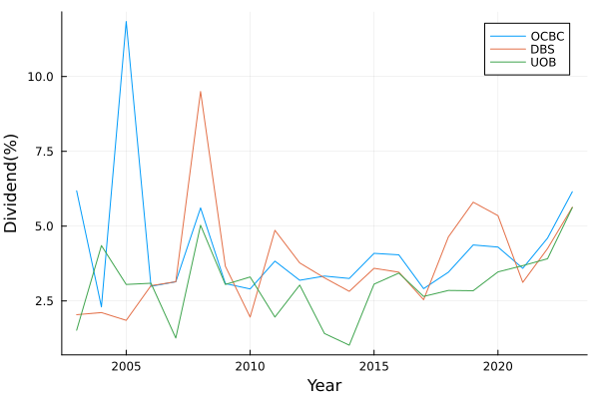
Dividends
This chart appears to show the dividend yield percentages over time for three banks: OCBC, DBS, and UOB. From the trends, it seems that the dividend yields have fluctuated but show a general increase in more recent years. Each of these three banks has been distributing dividends to its shareholders annually, and calculations show that the average dividend yield over the past 20 years has reached 3.51%. This figure is approximately 1% higher than the interest rate of the Central Provident Fund's (CPF) ordinary account, which has remained at 2.5% over the same period. We can consider the CPF interest rate as the risk-free rate. The consistency of this yield suggests a dependable return for investors in comparison to the CPF's stable interest rate.

Slide 11
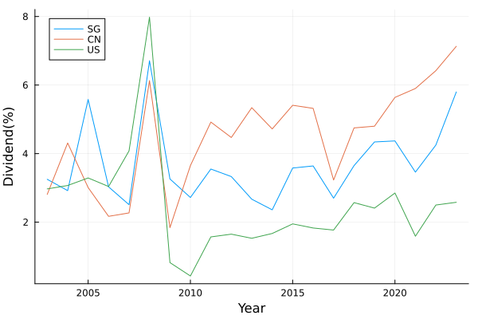
Comparison to Banks in China and US
In comparing the dividend yields of banks from Singapore, China, and the USA, selecting three top market-cap banks from each and averaging their dividend yields over the past two decades, we observe a trend starting from 2010. Chinese banks rank first in dividend yield, followed by Singaporean and then American banks. Singaporean banks show a trend of catching up with Chinese banks in recent years. The average dividend yields over the last 20 years for Chinese, Singaporean, and American banks are approximately 4.49%, 3.51%, and 2.55%, respectively. In a global comparison, Singaporean banks' dividend yields are at a moderate level.

Slide 12
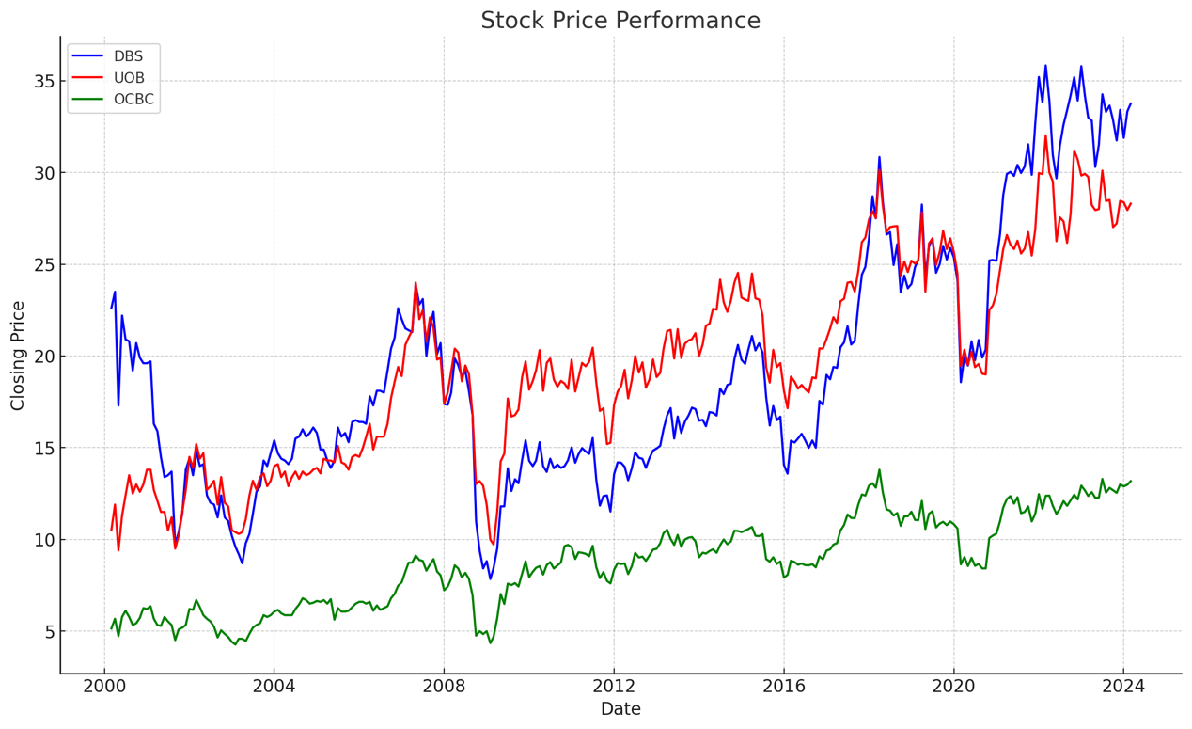
Volatility Analysis
Analyzing the standard deviations of these three banks, with DBS at 7.97, UOB at 6.58, and OCBC at 3.05, indicates that DBS has the highest volatility, followed by UOB, and OCBC has the lowest. This is also reflected in their stock price movements. Therefore, if you are a risk-averse investor, it's recommended to invest in OCBC. However, if you are willing to take on more risk for the potential of higher returns, DBS could be the better choice for investment.

Slide 13
Analysis on REITs

Slide 14
What is REITs
A real estate investment trust (REIT) is a company that owns, operates, or finances income-generating real estate. They package properties they owned as mutual trusts and put into equity market.
The function of REITs is similar to stock. They pool the capital of numerous investors. This makes it possible for individual investors to earn dividends from real estate investments without having to buy, manage, or finance any properties themselves. Compared with physical real estate investments, REITs is more accessible and liquid.
Moreover, REITs invest in most real estate property types, including apartment buildings, data centers, hotels, medical facilities, offices, retail centers, and warehouses etc. In other words, REITs is flexible in invest in commercial, public and residential property at same period. In contrast, the physical real estate investments may not achieve this diversification.
Singapore REITs are an important component of Singapore’s stock market
Largest REIT market in Asia ex-Japan. Specially, one-fifth the stock market of SG is taken by REITs.
Source: <https://www.reitas.sg/singapore-reits/overview-of-the-s-reit-industry/>

Slide 15
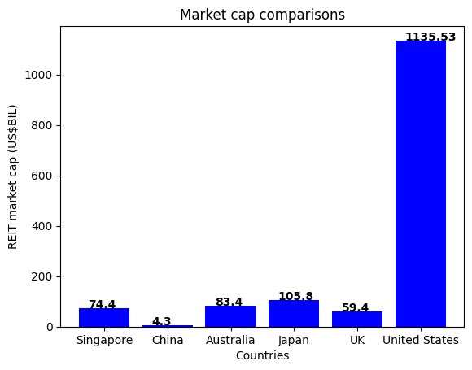
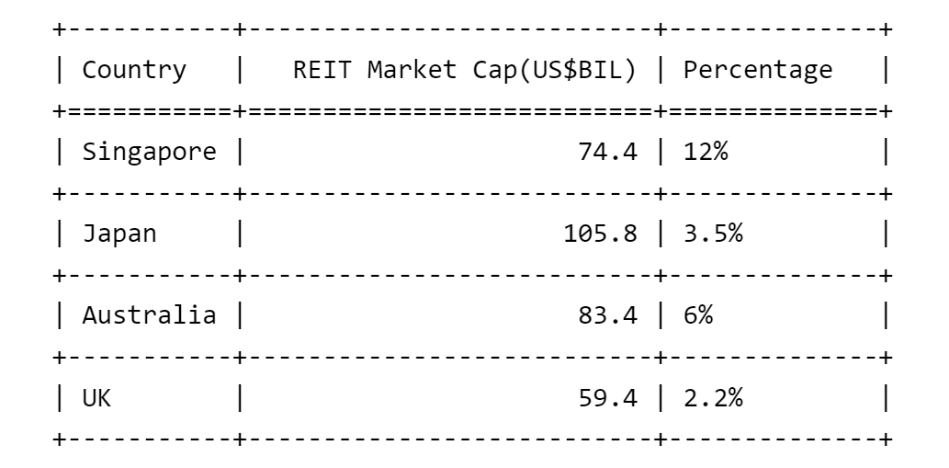
Market Cap
The market cap of S-REITs is comparable to Australia and UK. In percentage of the entire stock market, S-REITs shows a large impacts.

Slide 16
Characters of REITs
High dividends but low value
By law and IRS regulation, REITs must pay out 90% or more of their taxable profits to shareholders in the form of dividends.
As a result, REIT companies are often exempt from most corporate income tax. Hence, REITs provide a high dividend for investors.
*Forward dividend & yield*
The percentage of a company's current stock price that it expects to pay out as dividends over 12 months.
(Based on 15th March close price calculation)

Slide 17
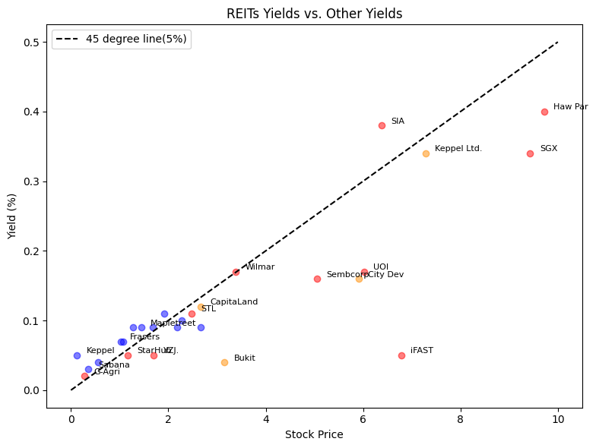
Research Subjects
REITs:
Sabana REIT (SGX: M1GU) (Singapore)
Keppel Pacific Oak US REIT (SGX: CMOU) (US)
Frasers Logistics & Commercial Trust (SGX: BUOU) (Singapore and Europe)
Mapletree Logistics Trust (SGX: M44U) (International)
Stocks in other sectors (Non-REITs):
SGX-Singapore Exchange Limited,
Singapore Telecommunications Limited,
Yangzijiang Shipbuilding (Holdings) Ltd.
Wilmar International Limited (5%) Agriculture Golden Agri-Resources Ltd
Singapore Airlines Limited; Utilities-Sembcorp Industries Ltd
Services-United Overseas Insurance Limited
Real-estate Stocks:
Keppel Ltd.
CapitaLand Investment Limited
City Developments Limited

Slide 18
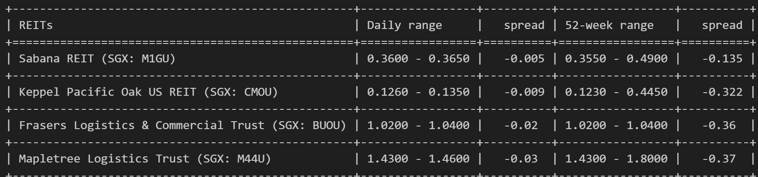
Stability
The forward dividends & yields of REITs is relative high. However, the price of REITs less than other stocks.
Why ?
The contractual nature of commercial real estate leases and the predictability of rental income and expenses,
give REITs a defensive quality - the price is relative stable at certain level.
The character of REITs allowing analysts to more accurately forecast earnings, which helps reduce share price volatility.

Slide 19
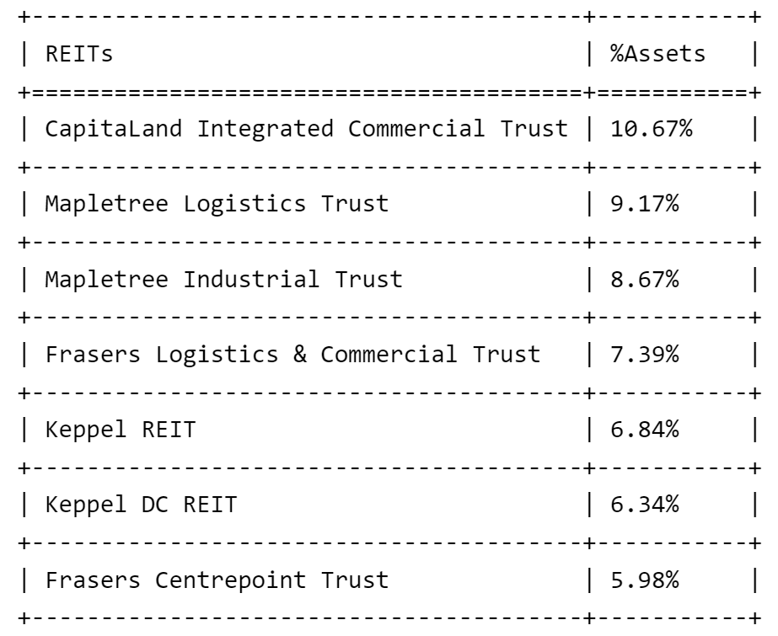
Exposure to global real estate
Over 90% of S-REITS own properties outside Singapore. Digging deeper in the systematic risk these REITs face.
For analysis, in this section, we use CSOP iEdge S-REIT Leaders Index ETF (SRU.SI) as a proxy for SREITs and SG real estate market.
Top 7 Holdings of CSOP iEdge S-REIT Leaders Index ETF (55.04% of Total Assets)

Slide 20
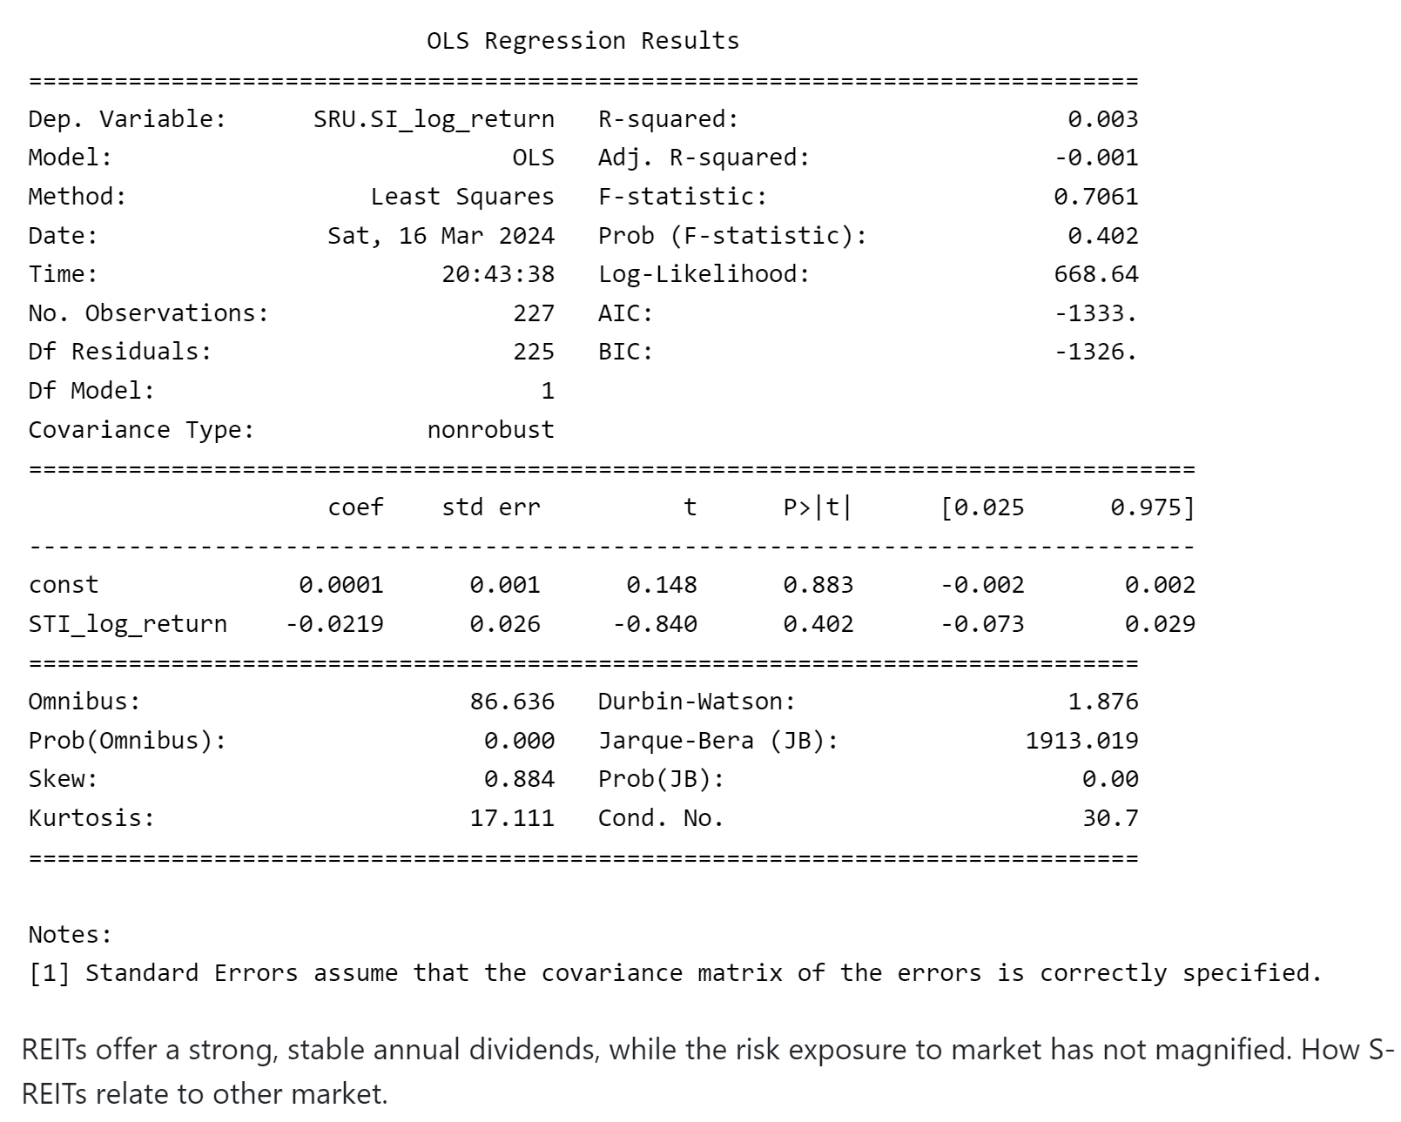
Regression

Slide 21
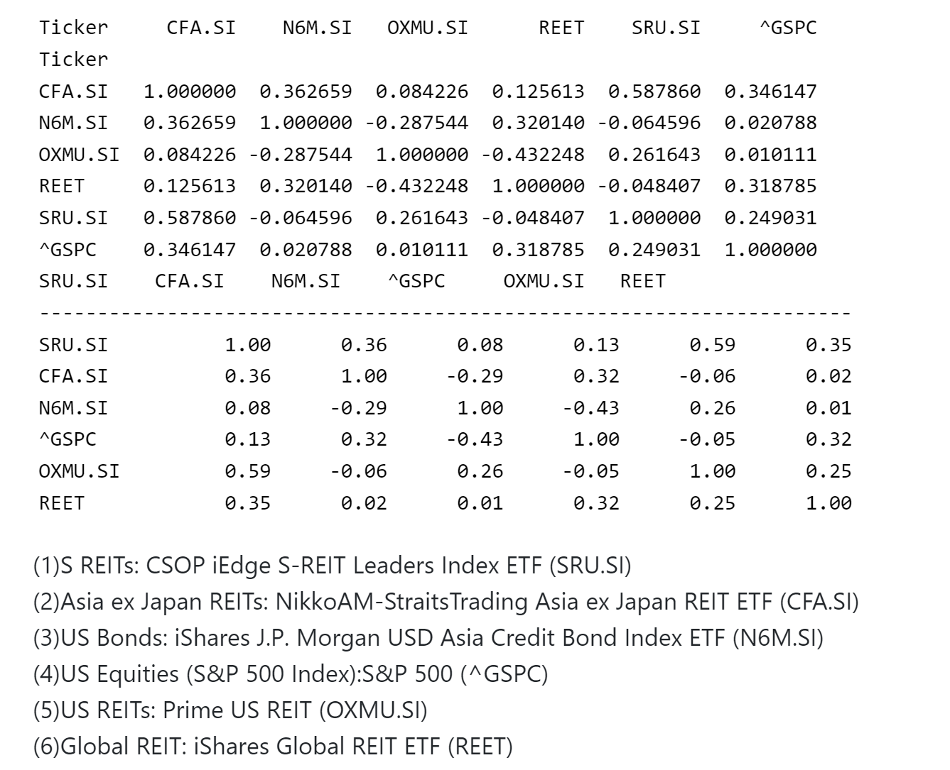
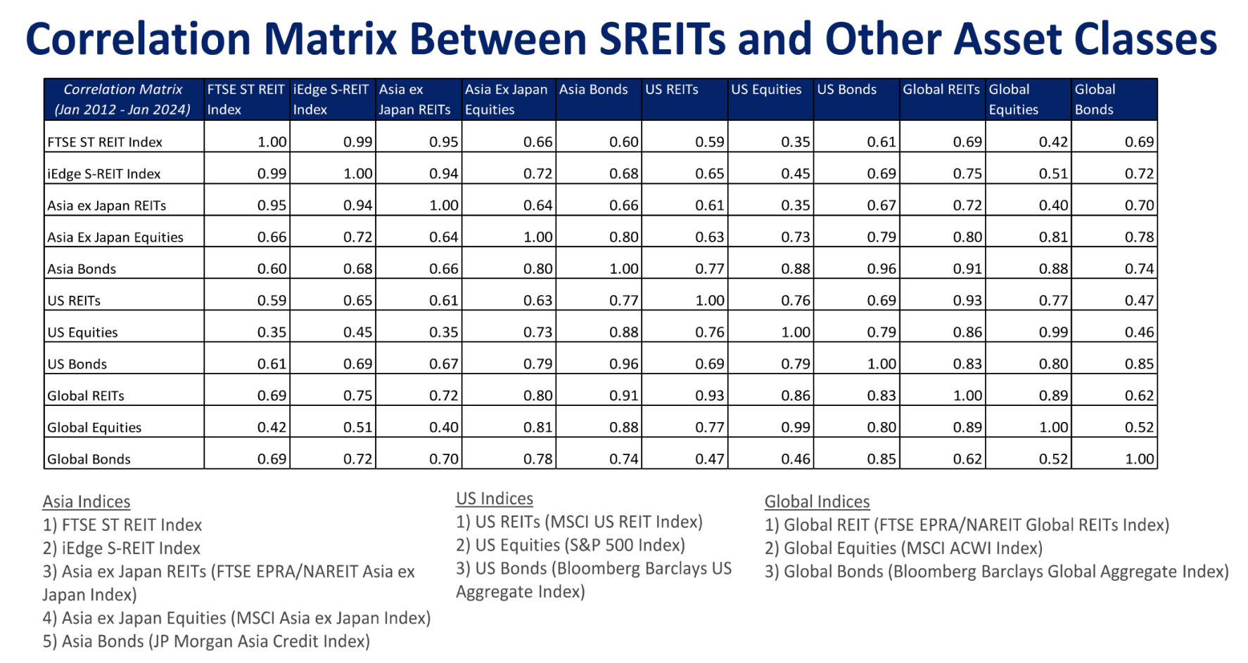
Correlation Analysis

Slide 22
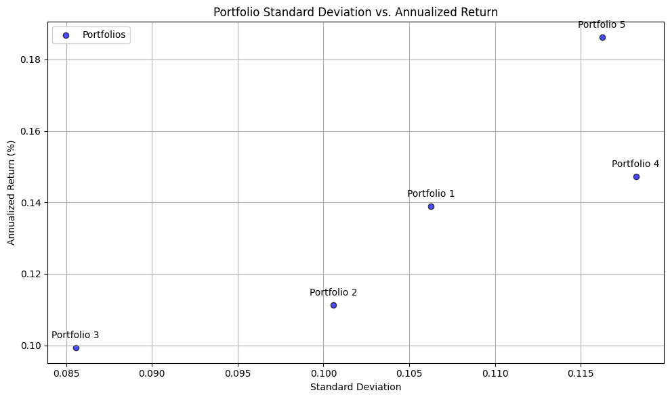
Diversification
REITs provide diversification benefits.
1. Generate following portfolios:
(1) 55% Market index funds + 35% Bonds + 10% REITs
(2) 40% Market index funds + 40% Bonds + 20% REITs
(3) 33.3% Market index funds + 33.3% Bonds + 33.3% REITs
(4) 60% Market index funds + 40% Bonds
(5) 80% Market index funds + 20% Bonds
Market index: S&P 500 (^GSPC)
Bonds: iShares 0-5 Year TIPS Bond ETF (STIP)
REITs: CSOP iEdge S-REIT Leaders Index ETF (SRU.SI)

Slide 23
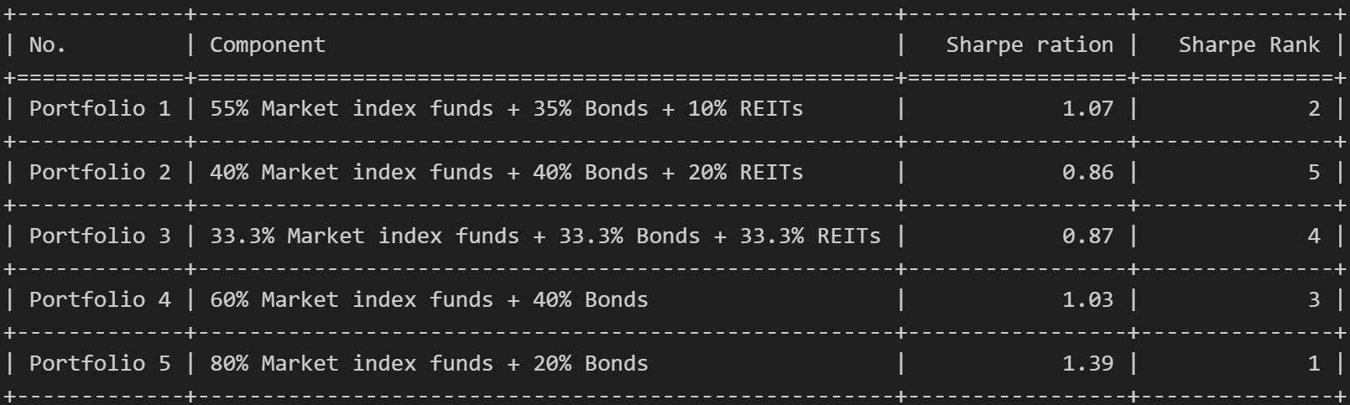
Portfolio Test

Slide 24
Risk and Liquidity

Slide 25
Research Method
The liquidity of stocks can be determined by various indicators. Considering the acquisition of data, we mainly use trading volume to represent the liquidity of stocks. Trading volume shows the number of buying and selling of stocks within a specific period of time, and is a key indicator that directly reflects liquidity. The average trading volume provides the average trading volume over a longer time frame, which helps evaluate the general liquidity level of stocks.
We mainly use volatility to measure the risk of stocks. Volatility is an indicator that measures the magnitude of stock price changes. The greater the volatility, the more intense the stock price changes, and the higher the risk. Meanwhile, we also consider that beta coefficient measures the volatility of stocks relative to the entire market. A beta coefficient greater than 1 means that the price fluctuation of a stock is greater than the market average, and the risk is higher; Less than 1 means less volatility than the market and relatively lower risk. Stocks with a beta coefficient close to 1 are usually considered to have price fluctuations consistent with the market, and lower or higher beta coefficients may indicate that stocks have more specificity.

Slide 26
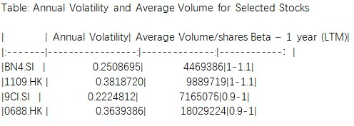
Liquidity
In order to analyze the liquidity and risk of the Singapore market, we compared it with the Hong Kong market, both of which are important financial markets in Asia. On Yahoo Finance, we screen companies in each market based on Beta-1 year (LTM) data (as the website does not provide specific data for this item, it can only be controlled within a rough range) between 0.9-1 and 1-1.1 to reduce the specificity of stocks, and ensure that they are all related to the same industry. We have chosen the following four real estate related stocks:
Keppel Ltd (BN4.SI)，
China Resources Land Limited（1109.HK）
CapitaLand Investment Limited (9CI.SI)
China Overseas Land & Investment Limited (0688.HK)
Calculate the annual volatility and average trading volume of each company for the previous year to obtain the following data: (Beta 1 year (LTM) is an additional addition)
Based on the calculation results, we can believe that compared to the Hong Kong market, the liquidity of the Singapore market is lower, and the risk will also be relatively low.

Slide 27
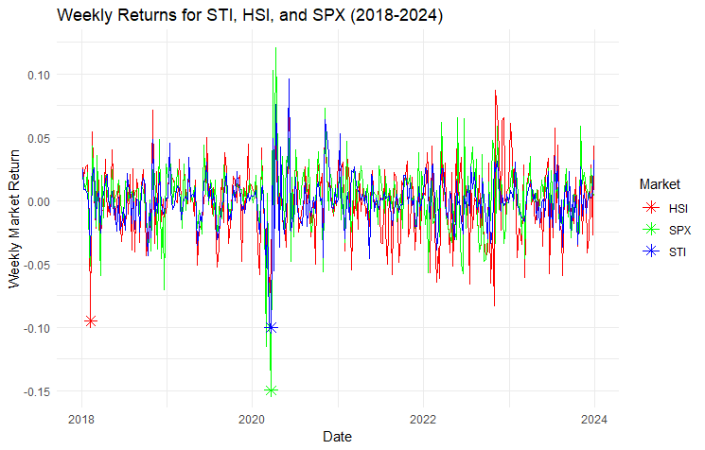
Volatility
Analyzing recent market fluctuations, especially from January 1, 2018 to January 1, 2024, we have found that the COVID-19 pandemic has had a profound impact on global stock markets. In this analysis, we specifically focused on three major stock market indices: the Singapore Stock Exchange Composite Index (STI), the S&P 500 Index (SPX), and the Hong Kong Hang Seng Index (HIS). By calculating the weekly return rate during this period and identifying the largest decline points in each market, we can gain a deeper understanding of the specific impact of the epidemic on these indices.
Based on our analysis results, it is clear that during the early stages of the COVID-19 pandemic, global stock markets experienced a significant decline. However, compared to the United States, the S&P 500 index (SPX) had a larger volatility, while the Singapore Stock Exchange Composite Index (STI) and Hong Kong Hang Seng Index (HIS) had relatively smaller volatility.

Slide 28
THANKS FOR LISTENING
FNCE6006-G1-Financial Econometrics
Group 2: Wengwei, Cao Danyang, Ma Tianqi, Luo Hao, Liu Qinglin

